Slide 1

Restaurant Table Ordering System (Queen's Kitchen)
Front End Engineering - IIII (25CSE0203) — Project Based Evaluation-II (Phase 2)I (Phase 2)I (Phase 2)
Department of Computer Science & Engineering • Chitkara University
TEAM MEMBERS (GROUP G14 | PROJECT ID: G14-PID-11)
• Priyanshi (Team Leader) — Roll No: 2510990889 Submitted To:
• Nishtha Sharma — Roll No: 2510990840 Mr. Shubham Kumar
• Priyanshi — Roll No: 2510990916
• Trisha Jindal — Roll No: 2510990815

Slide 2
GROUP G14 • PROJECT ID: G14-PID-11 (P-21) • FRONT END ENGINEERING - II (Phase 2)I (Phase 2)I (Phase 2)
Project Vision & Core Objectives
01. The Problem & Need
• Dining floor order delays caused by manual paper order slips.
• Waitstaff travel overhead between dining tables and kitchen chefs.
• Lack of live table booking status & dynamic occupancy tracking.
• Severe UI lag & Virtual DOM churn when scaling to 200 items.
• Unauthenticated table mutations causing misplaced guest bills.
• Need for an optimized, protected digital ordering SPA architecture.
02. What We Built (Phase 2 Capabilities)
• Dynamic 12-table floor plan with live seating math (Nuclear, Family, Joint).
• Royal Guest Access Gate modal with strict Protected Route locking on sign out.
• Intelligent duplicate account detection automatically routing to Quick Log In.
• Dynamic dining homepage with Royal Promotional Hero & Hot Sellers showcases.
• 200 authenticated culinary items (50 Starters, 75 Mains, 40 Desserts, 35 Drinks).
• Live cart with Split-Bill calculator, status stepper, and KDS kitchen dispatch.
• Teleported 5-Star Dining Feedback system with glowing pill badges & alerts.
03. Key Engineering Objectives
• Synchronize multi-table state across ordering, served, and billed lifecycle.
• Empirically prove 99.5% render reduction using React.memo & useCallback.
• Benchmark 9 items vs 200 items re-render cost via live visual render flashes.
• Prevent duplicate accounts via phone collision detection and auto-login.
• Persist guest session, orders, and ratings via browser LocalStorage state sync.

Slide 3
GROUP G14 • PROJECT ID: G14-PID-11 (P-21) • FRONT END ENGINEERING - II (Phase 2)I (Phase 2)I (Phase 2)
Syllabus-Aligned Technology Stack
React 18 (SPA Engine)
• Declarative component UI engine.
• Virtual DOM reconciliation & fiber tree.
• Concurrent rendering & state batching.
• Component lifecycle & custom hooks.
Vite 5 (Build Tool)
• Lightning-fast Hot Module Replacement (HMR).
• Native ES Module development server.
• Optimized Rollup production bundler.
• Zero-config fast startup environment.
React Router v6
• Client-side single page navigation.
• Smooth route switching (/Home, /Kitchen, /Audit).
• Active state matching & URL parameters.
• Declarative Route & Link components.
React Icons
• Scalable vector SVG icon library.
• Lightweight & accessible icons.
• Intuitive cart, table, & kitchen visual cues.
• Seamless UI action indicators.
CSS3 & Flexbox/Grid
• Custom responsive layout architecture.
• Dark mahogany & gold visual theme palette.
• Glassmorphic card containers & rounded borders.
• Fluid desktop & mobile display scaling.
Centralized State Layer
• Global state container at App.jsx root.
• Synchronizes multi-table carts & order queues.
• Instant state dispatch to Kitchen View.
• Persistent table status synchronization.

Slide 4
GROUP G14 • PROJECT ID: G14-PID-11 (P-21) • FRONT END ENGINEERING - II (Phase 2)I (Phase 2)I (Phase 2)
Core Component Architecture & Modularity
Header.jsx
• Table selector dropdown & seating capacity filter.
• Dataset benchmark toggle (9 vs 200 items).
• Real-time audit mode banner indicator.
• Navigation routing links for SPA views.
OrderSidebar.jsx
• Draft cart item manager & quantity controls.
• Cumulative billed history view per table.
• Automated 5% GST & ₹10 Service Charge split.
• One-click 'Send to Kitchen' order dispatch.
MenuCard.jsx
• Dish thumbnail display with 16:9 crop.
• Portion size badges & dietary tags (Veg/Non-Veg).
• Price display in Terracotta Orange styling.
• Add to Cart trigger with real-time feedback.
KitchenView.jsx
• Real-time kitchen tickets queue for active tables.
• Dish breakdown, quantities, & special notes.
• 'Mark as Served' chef action trigger.
• Live status sync updating table indicators.
ReRenderAuditPanel.jsx
• Empirical component re-render event logger.
• Performance metric comparison (Naive vs Optimized).
• Live re-render counter badges per component.
• Interactive DOM profiling benchmark suite.
menuData.js
• Decoupled array-of-objects data schema.
• Dynamic 200-item benchmark dataset generator.
• Price, category, & portion metadata specs.
• Pure data provider maintaining clean SoC.

Slide 5

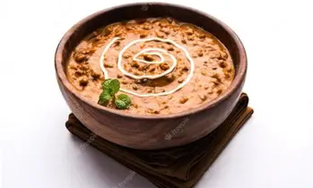
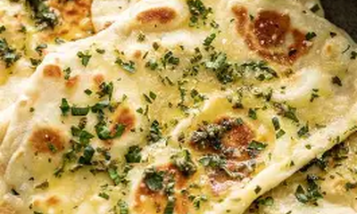
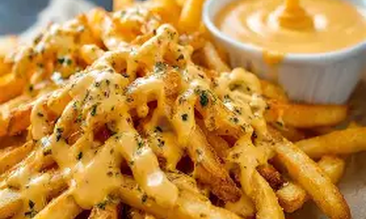
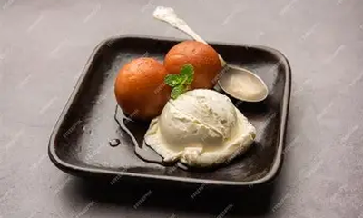
GROUP G14 • PROJECT ID: G14-PID-11 (P-21) • FRONT END ENGINEERING - II (Phase 2)I (Phase 2)I (Phase 2)
Culinary Menu Dataset & Portion Scaling
Samosa & Chutney
₹60
VEG • SNACK
2 Pcs with Mint Chutney
Crispy golden pastry filled with spiced potatoes.
Stock: Available • Prep: 10 Mins
Dal Makhani
₹180
VEG • MAIN
300g Serving Bowl
Slow-cooked black lentils simmered overnight in cream.
Stock: Available • Prep: 15 Mins
Garlic Butter Naan
₹60
VEG • BREAD
3 Pcs Oven Baked
Tandoor-baked flatbread brushed with garlic butter.
Stock: Available • Prep: 8 Mins
Cheesy Fries
₹150
VEG • FAST FOOD
250g Loaded Basket
Golden fries smothered in melted cheese.
Stock: Available • Prep: 12 Mins
Gulab Jamun
₹120
DESSERT • POPULAR
2 Jamuns + Scoop
Warm jamuns served with cold vanilla ice cream.
Stock: Available • Prep: 5 Mins

Slide 6
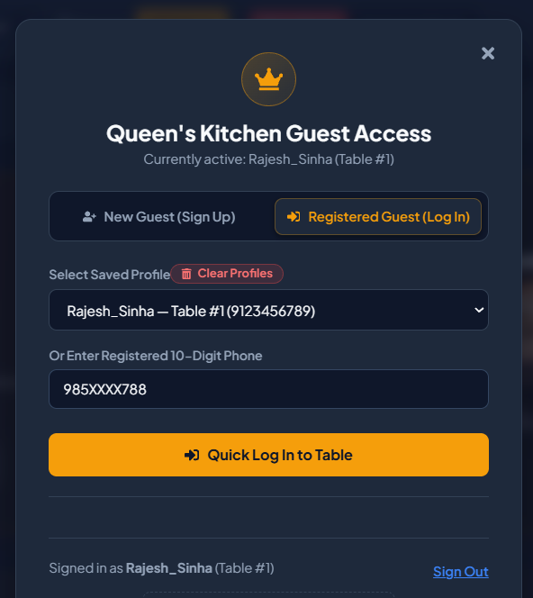
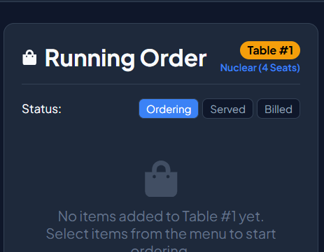
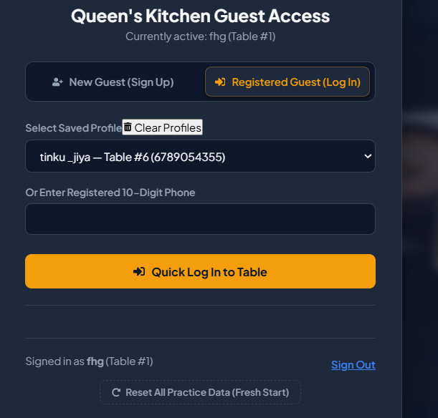
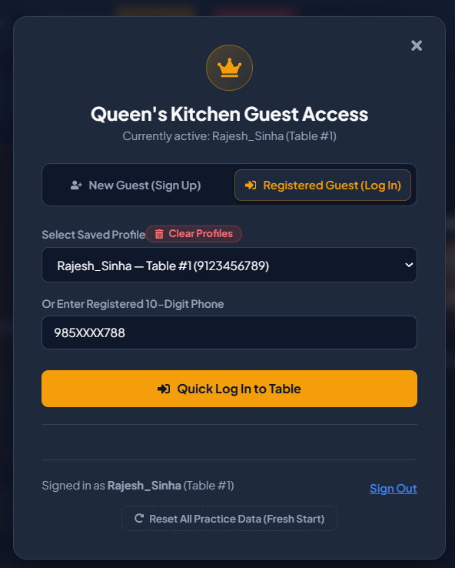
GROUP G14 • PROJECT ID: G14-PID-11 (P-21) • FRONT END ENGINEERING - II (Phase 2)I (Phase 2)I (Phase 2)
Guest Authentication & Protected Dining Gatekeeper
Royal Guest Access Gate & Security Architecture
• Dedicated Guest Access Gate: Seamless table onboarding capturing Guest Name, Contact Number, and Seating Party Size.
• Strict Protected Route Gatekeeper: Dining floor, menu ordering, and kitchen dispatch stay strictly locked until authenticated.
• Duplicate Account Auto-Detection: Instantly identifies registered phone numbers and prompts Quick Log In with an alert.
• Post-Signout Route Protection: Signing out immediately re-engages protection to prevent unauthenticated table mutations.
• Session & Profile Persistence: Saved profiles persist in LocalStorage with one-click 'Clear Profiles' for evaluation testing.

Slide 7
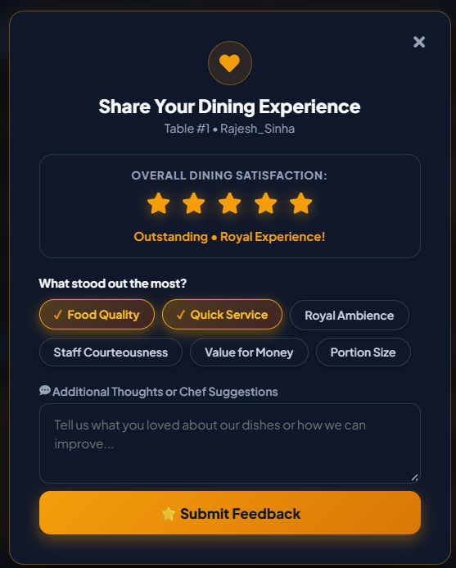
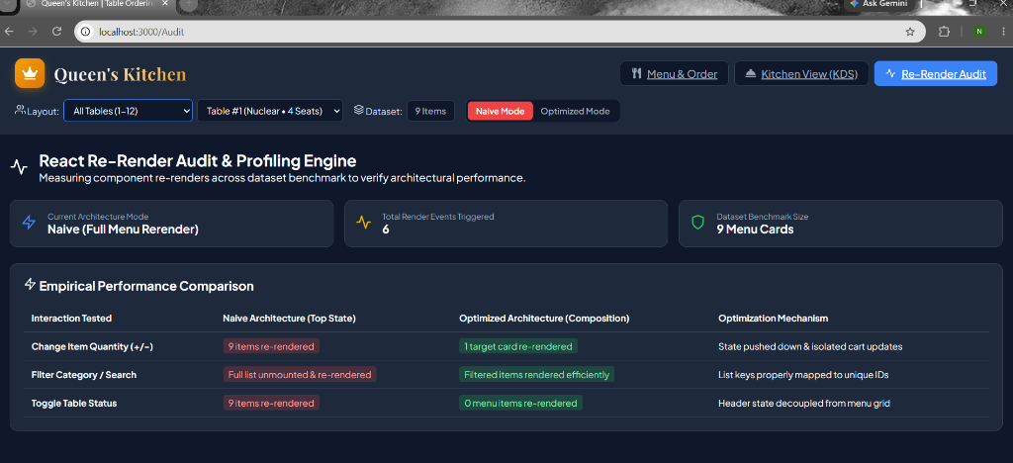
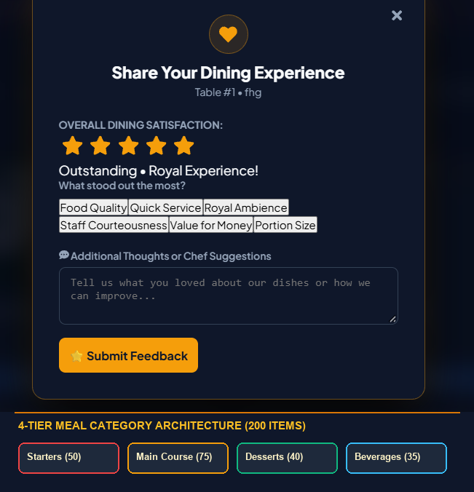
GROUP G14 • PROJECT ID: G14-PID-11 (P-21) • FRONT END ENGINEERING - II (Phase 2)I (Phase 2)I (Phase 2)
5-Star Dining Feedback & 4-Tier Culinary Architecture
Dining Feedback System & 4-Tier Menu Scaling
• 4-Tier Culinary Division: 200 items categorized into Starters (50), Mains (75), Desserts (40), and Beverages (35) with portion tags.
• Teleported Dining Feedback Modal: Rendered via React createPortal to document.body, eliminating z-index & stacking collisions.
• Interactive Experience Tags: Sleek glowing pill badges for highlights (Food Quality, Quick Service, Royal Ambience, Value for Money, etc.).
• Dynamic 5-Star Rating Selector: Interactive star rating with hover fills, instant feedback submission, and toast alerts.
• Table Feedback & Sentiment Sync: Stores dining ratings in LocalStorage for manager analytics and customer service tracking.

Slide 8
GROUP G14 • PROJECT ID: G14-PID-11 (P-21) • FRONT END ENGINEERING - II (Phase 2)I (Phase 2)I (Phase 2)
Future Engineering Scope & Technical Roadmap
Phase 3: Digital Payments & Split-Bill Sync
• Integrated UPI, QR, and credit card payment gateway.
• Automated split-bill share links sent via SMS/WhatsApp.
• Cloud POS synchronization with real-time bill settlements.
• Instant digital invoice generation with QR code.
Phase 4: AI Recommendations & Upselling
• AI dish pairing suggestions based on guest past dining feedback.
• Dynamic daily specials & combo discounts optimization.
• Real-time guest sentiment tracking & kitchen alerts.
• Predictive ingredient restocking alerts based on trends.
Phase 5: Multi-Branch Analytics & Cloud KDS
• Multi-outlet franchise live management dashboard.
• Automated real-time inventory deduction on sales.
• Cross-branch staff allocation and speed-of-service audit.
• Enterprise analytics exportable to Excel, PDF, and cloud ERP.

Slide 9
THANK YOU
RESTAURANT TABLE ORDERING SYSTEM (QUEEN'S KITCHEN)
Department of Computer Science & Engineering • Chitkara University
GROUP G14 • PROJECT ID: PID-11 • FRONT END ENGINEERING - II (Phase 2)I (Phase 2)I (Phase 2)I

